Slide 1


For parents, by parents:
This presentation is intended to raise awareness - whether at a parent-teacher evening, a meeting of the parent council, an association gathering or a similar event.
You can adapt it to suit your audience
and your specific setting.
This presentation may be shared and modified under a Creative Commons license. It may not be used for commercial purposes. The association Smartphone-free Childhood Switzerland must be credited as the creator.
***Note to the presenter: please do not show this slide.***

Slide 2
Please note: This presentation may only be used for non-commercial purposes.
Any commercial use or adaptation for commercial purposes is not permitted.
This presentation is designed as an input from parents, for parents. It can be shared at parent-teacher meetings, parent council meetings, meetings of clubs and associations, etc.
It provides information to raise awareness about the topic
of smartphones among children and young people.
This presentation may be shared and modified under a Creative Commons license. It may not be used for commercial purposes. The association Smartphone-free Childhood Switzerland must be credited as the author.
***Note to the presenter: please do not show this slide.***

Slide 3
Proposed timeline
Look for allies
Request a date for the presentation
Obtain a go-ahead
for the presentation
Download the presentation from the association
Give the presentation
Next steps
Follow-up
1
2
3
4
5
6
7
Wherever possible, discuss the issue beforehand with like-minded parents as well as with the person responsible at the venue.
Can you expect to face resistance or receive support?
Ideal:
15 minutes presentation,
10 minutes discussion.
You could present at a parent council evening, a club or association meeting, etc.
Set a date for the presentation at the venue.
Review the material and check it for comprehensibility..
Present to parents of the class, to a club or association, etc.
Gather contact details from interested parents.
After 1-2 weeks, follow up with participants to discuss the next steps.
Send the presentation to all parents.
***Note to the presenter: please do not show this slide.***

Slide 4

Resources for parents
The website of Smartphone-freie Kindheit Schweiz includes a section with resources for parents. In this section, you will find various flyers and sample letters for schools.
The website is continuously updated and expanded.
Link to the resources: https://www.smartphonefreiekindheit.ch/#ressourcen
***Note to the presenter: please do not show this slide.***

Slide 5
Let us know how it went!
It's great that you are involved in raising awareness about smartphones among children and young people.
Every presentation is a catalyst for change.
Please share your experiences with us, and we would love to receive your feedback (or photos).
info@smartphonefreiekindheit.ch
***Note to the presenter: please do not show this slide.***

Slide 6
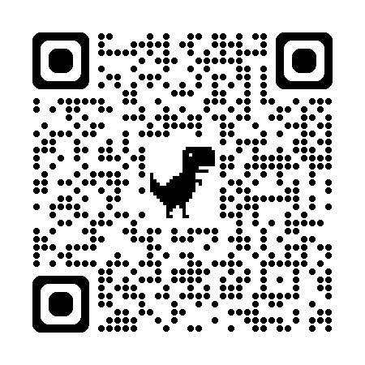
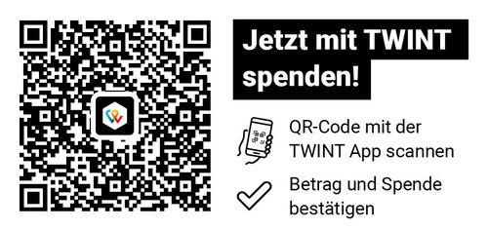
Possible further steps
With this presentation, you are making a powerful statement for a smartphone-free environment for your child. You can also engage against digital peer pressure at the national level, by becoming a member of the movement – ​​for a smartphone-free childhood in Switzerland.
We hope this presentation helps you create a smartphone-free environment for your child. We put a lot of volunteer work and effort into creating resources like this, but not everything is free. Help us reach even more parents with a donation.
Become a member!
www.sfks.clubdesk.com/werde_mitglied
***Note to the presenter: please do not show this slide.***

Slide 7
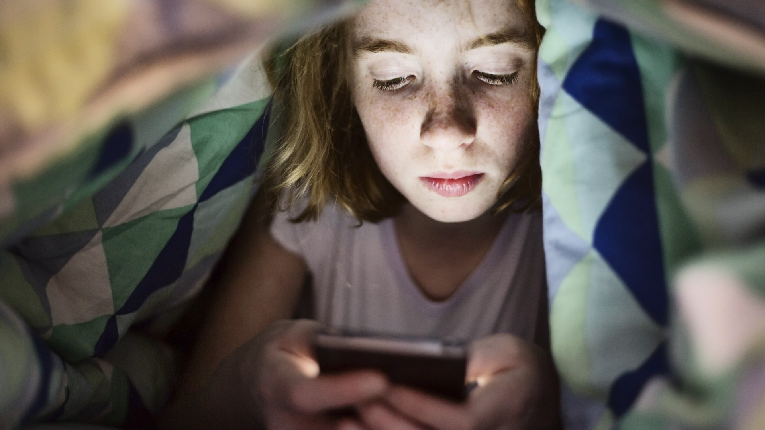

Smartphones are a
new challenge of parenting

Slide 8


When is the right time for a child to receive
his/her own smartphone?
Many of us see the negative impact of smartphones. Yet, many children receive their own device at a young age.
It is almost impossible to escape peer pressure when children's social lives take place on their smartphones.
Parents and young people often feel
like they have no choice.

Slide 9
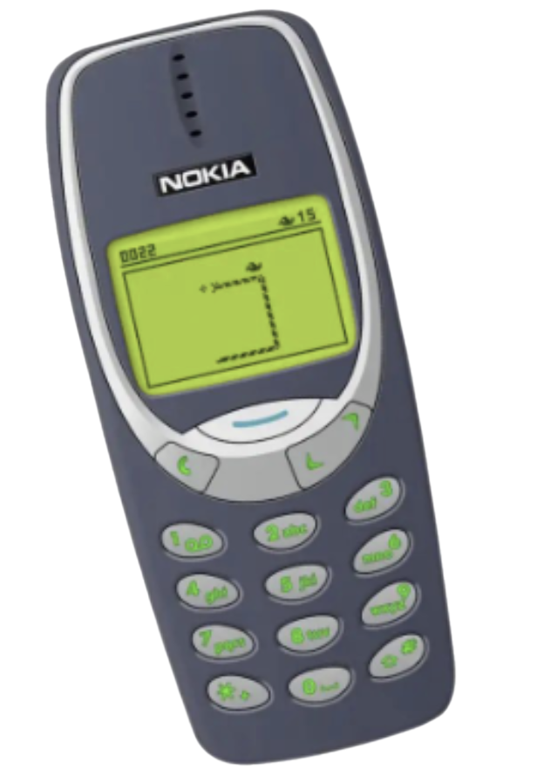
Being the only parent who says
“no” feels nearly impossible
If enough parents agree to delay giving children their own smartphone,
peer pressure decreases.
Together we are strong.
A collective problem requires collective action.

Slide 10
But why exactly are smartphones
a problem for children/teenagers?

Slide 11
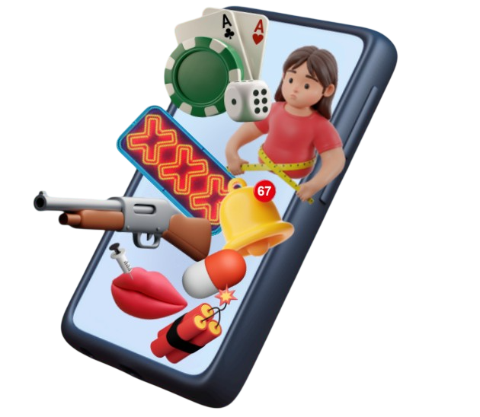
Smartphones are not just telephones
Mobile phone
Making calls,
sending SMS,
playing Snake
Pocket computer
Unfiltered internet and countless apps are fighting for attention and screen time
…and they can have serious side effects
in children.

Slide 12
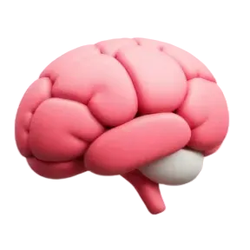
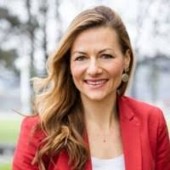
Influence on brain development
“Notifications, likes and scrolling cause dopamine surges in the brain. This overactivation in the reward center raises the threshold for experiencing pleasure in real life, and weakens the ability for self-regulation and delaying gratification.” (translation)
Barbara Studer
Neuroscientist, Co-founder of Hirncoach AG
www.hirncoach.ch

Slide 13
Influence on brain development
“Excessive use of smartphones and social media by children and adolescents has been shown to cause structural changes in the brain. Early developmental phases are particularly sensitive – not everything can be made up for easily later. Experiences during
this time have a lasting impact and they can make a crucial difference in the long run.” (translation)
Barbara Studer
Neuroscientist, Co-founder of Hirncoach AG
www.hirncoach.ch

Slide 14

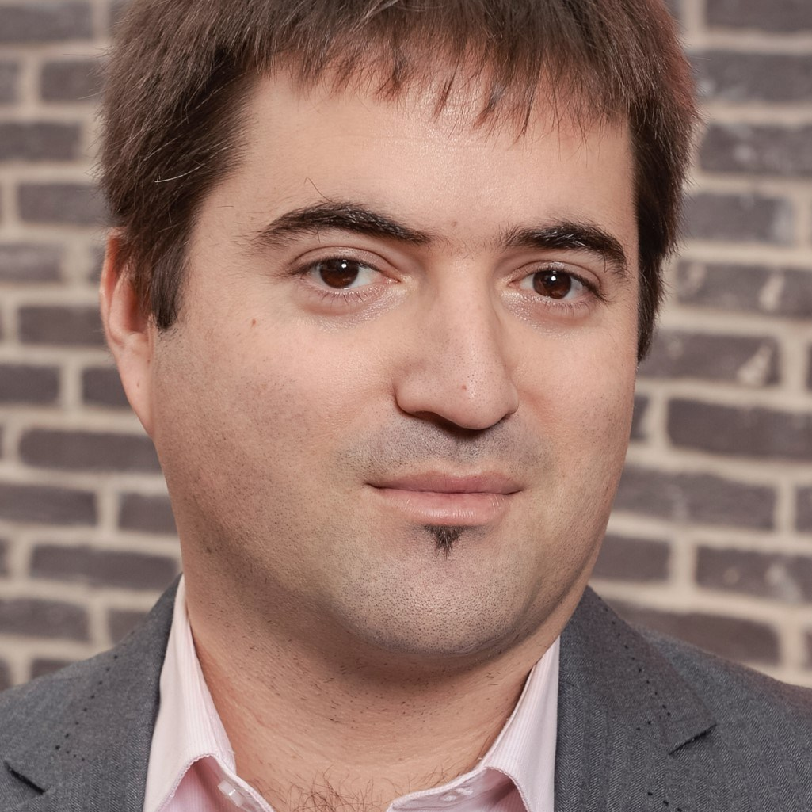
Smartphones influence mental health, weight and sleep
For a 12-year old child who owns
his/her own smartphone, the risk of …
…depression increases by ~30%
…obesity increases by ~40%
…insufficient sleep by ~60%
as compared to a child of the same age without a smartphone.*
* Comparative study among 10,500 children, published end of 2025
Ran Barzilay
MD, PhD, Psychiatrist Youth Suicide
Children's Hospital of Philadelphia

Slide 15
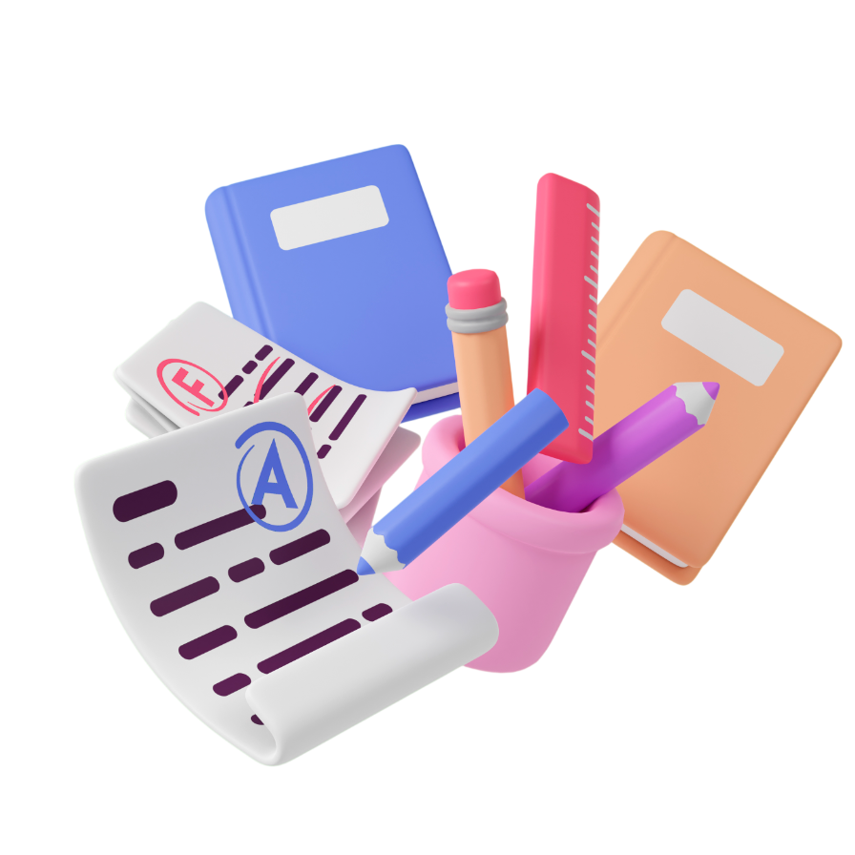
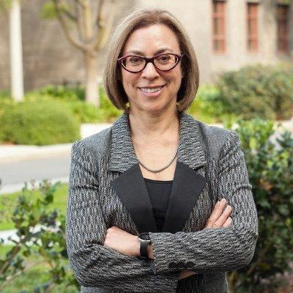
Distractions from a smartphone waste learning time
After a single distraction from a smartphone, it can take up to
23 minutes to regain concentration. Multiple distractions add up: most pupils and students never achieve deep concentration.
Gloria Mark
Department of Informatics
University of California

Slide 16
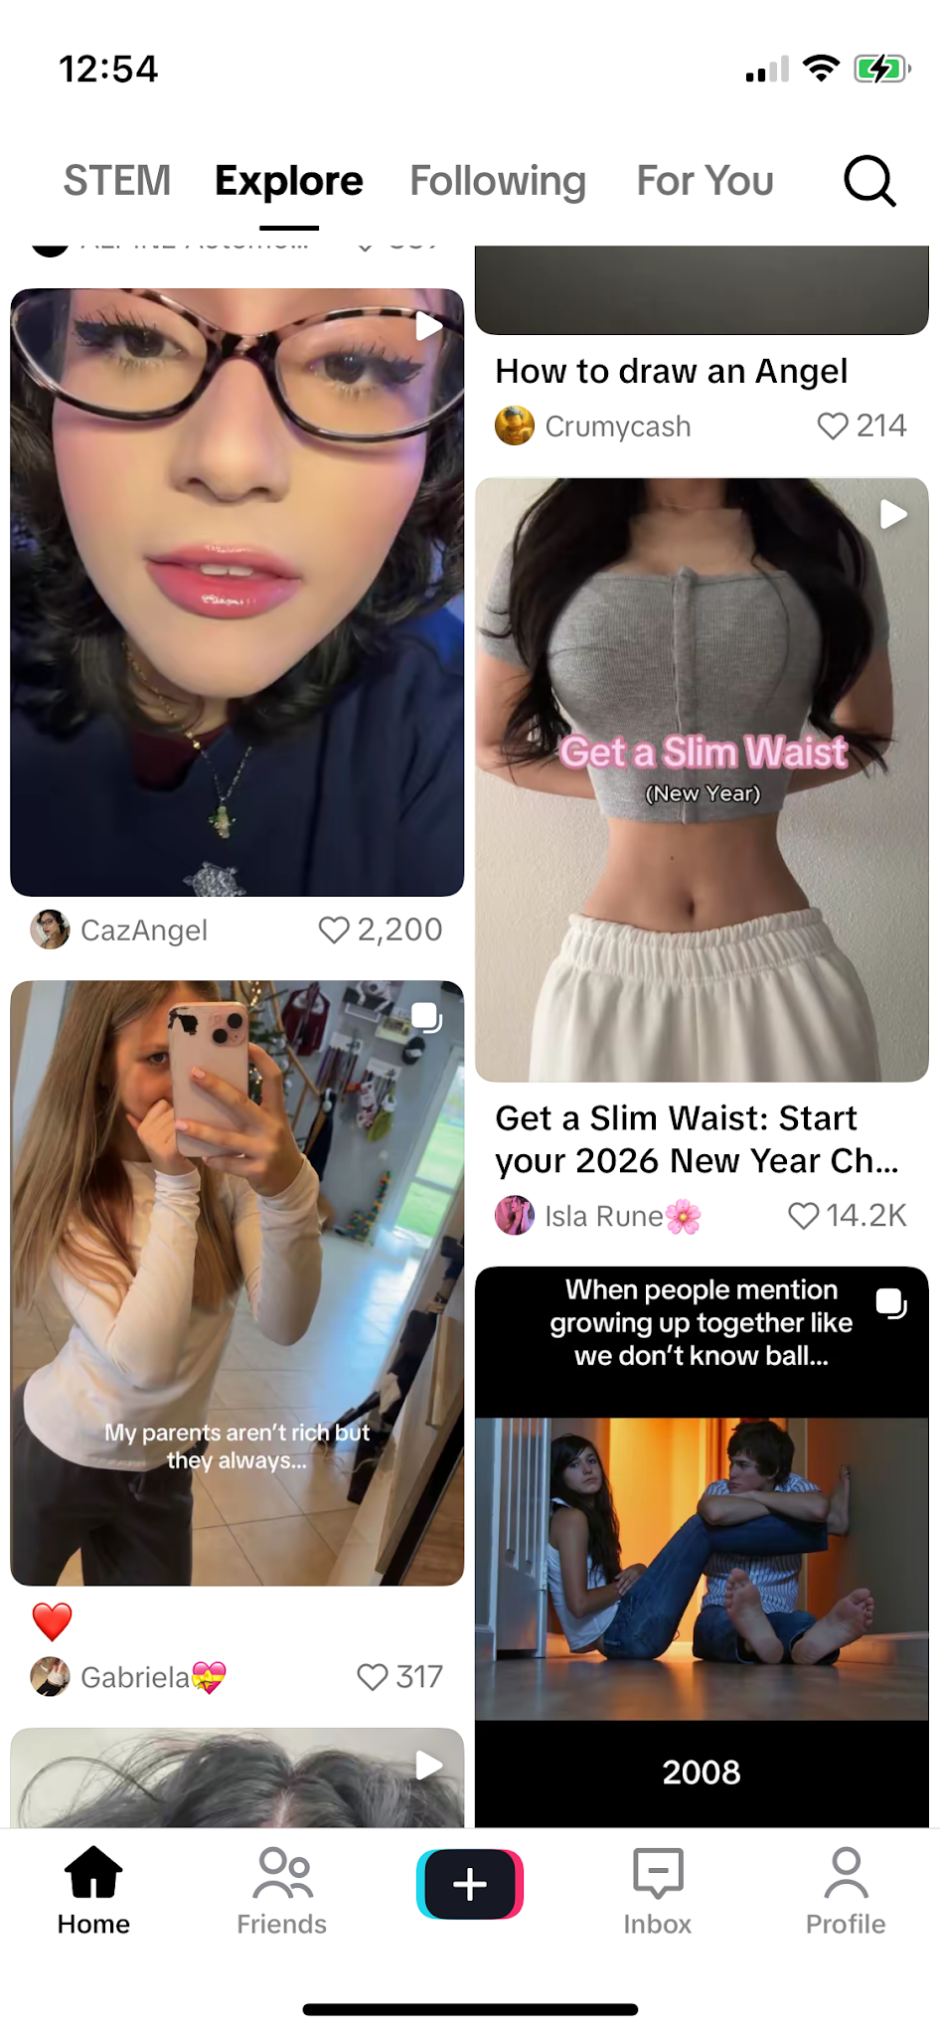
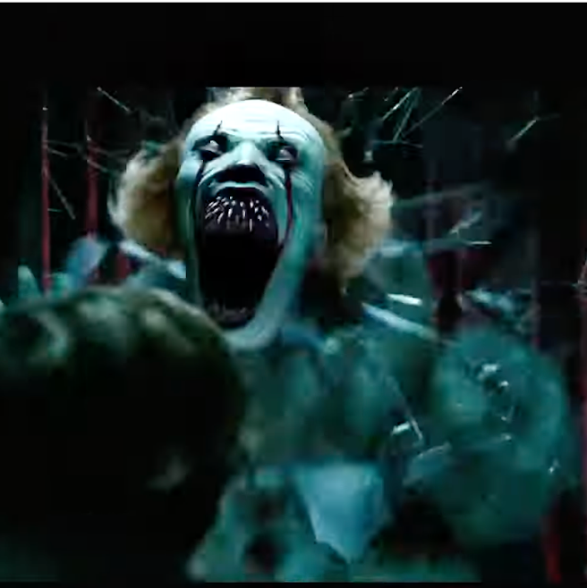
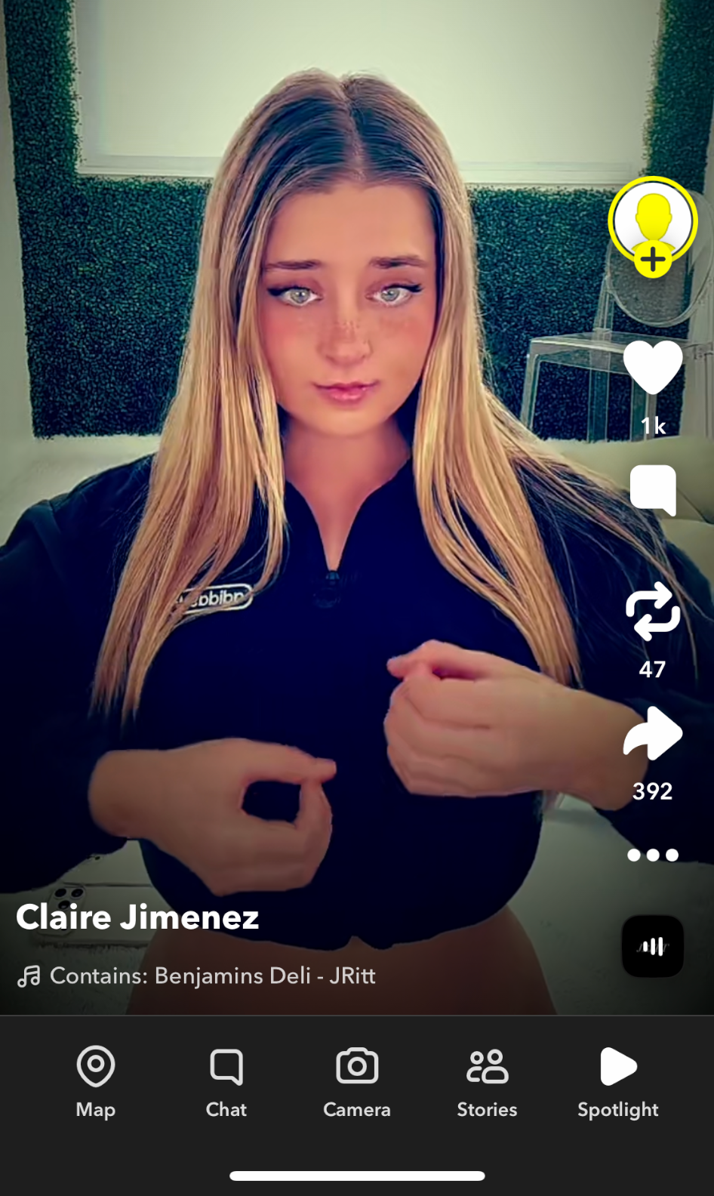
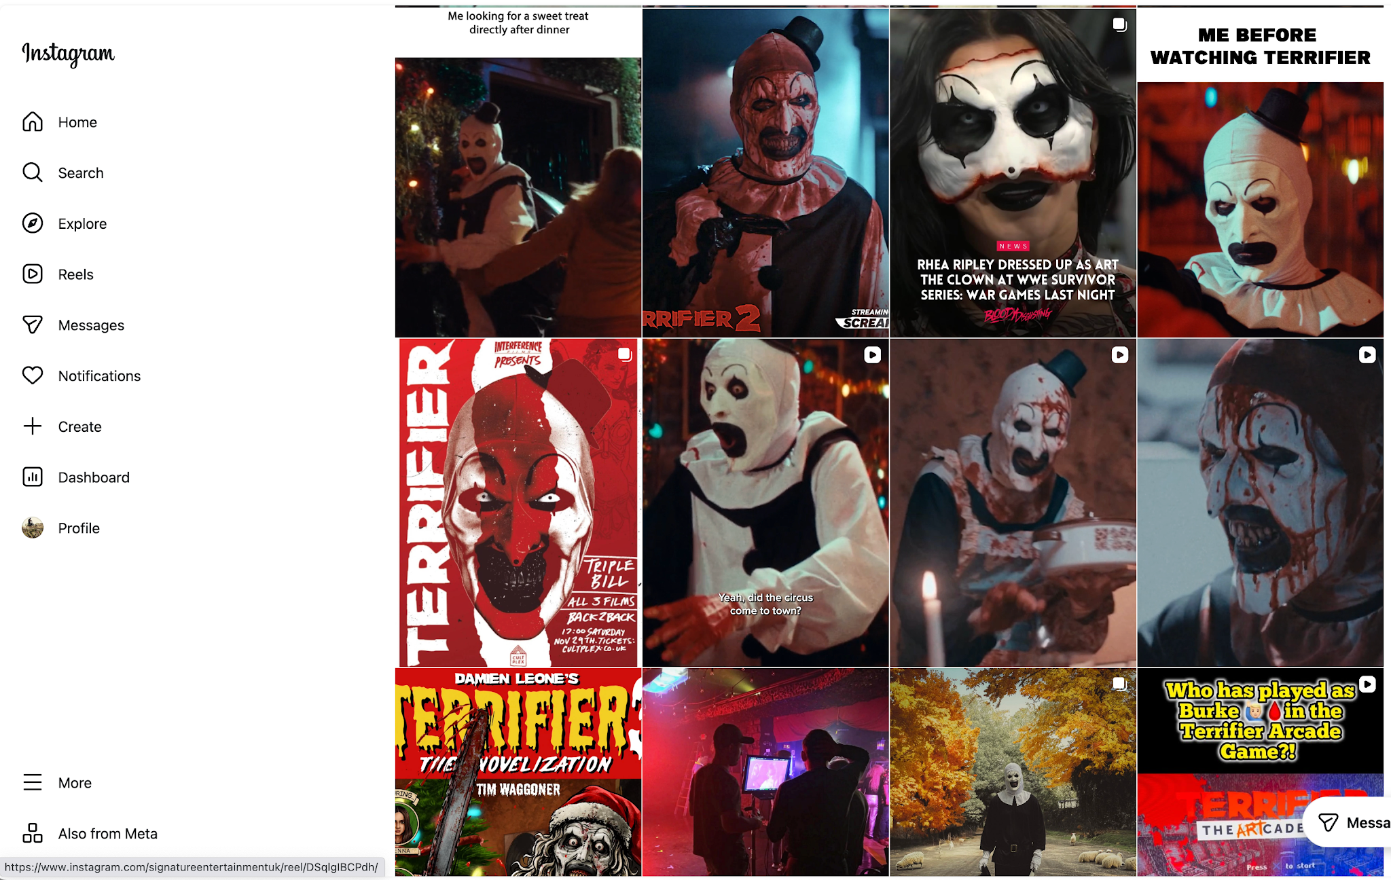
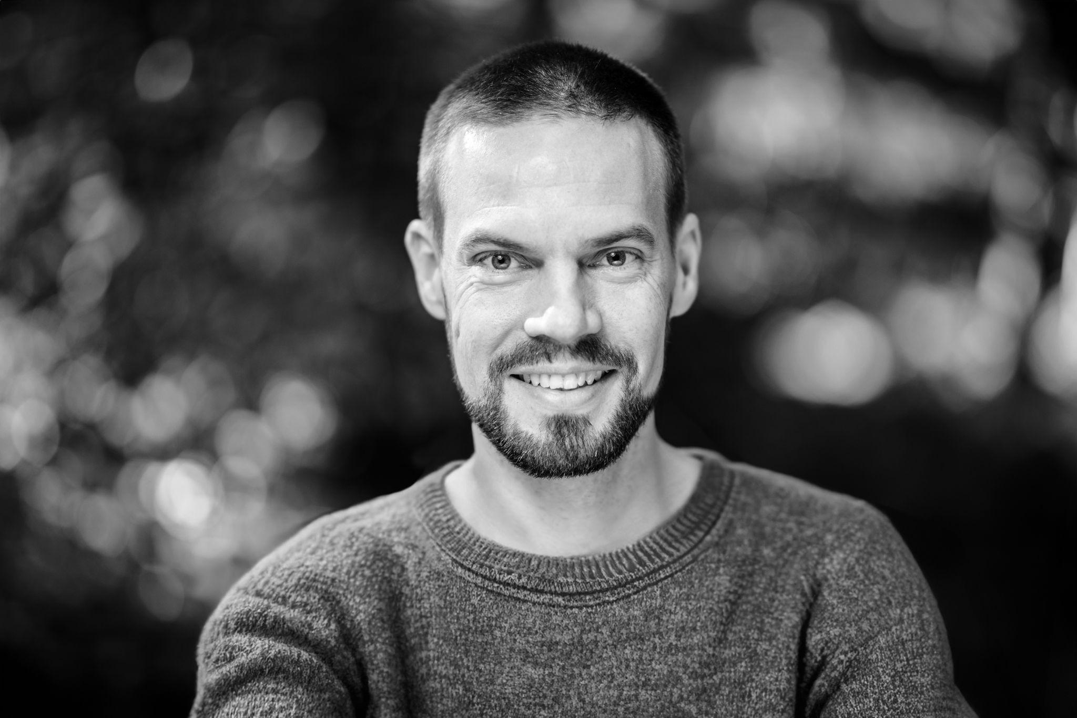
TikTok
YouTube
Test account as a 13-year old
“After only a few seconds on TikTok and Snapchat, the algorithm serves up pornography. Children don't usually search for it; the platforms push it. 83% of all young people are confronted with disturbing and inappropriate content every month.” (translation)
The inserts are screenshots from children’s accounts (13 years) or freely accessible content.
Statistics from JIM, 2025
Snapchat
David Murdoch
Digital media educator
Founder of PixelKäse
Instagram

Slide 17
Digital devices are a complex topic
The challenges are multifaceted.
Unfortunately, there are no simple or
universally applicable solutions.
Every family is different, and every child is unique.
And yet:
A collective approach can simplify many things!

Slide 18

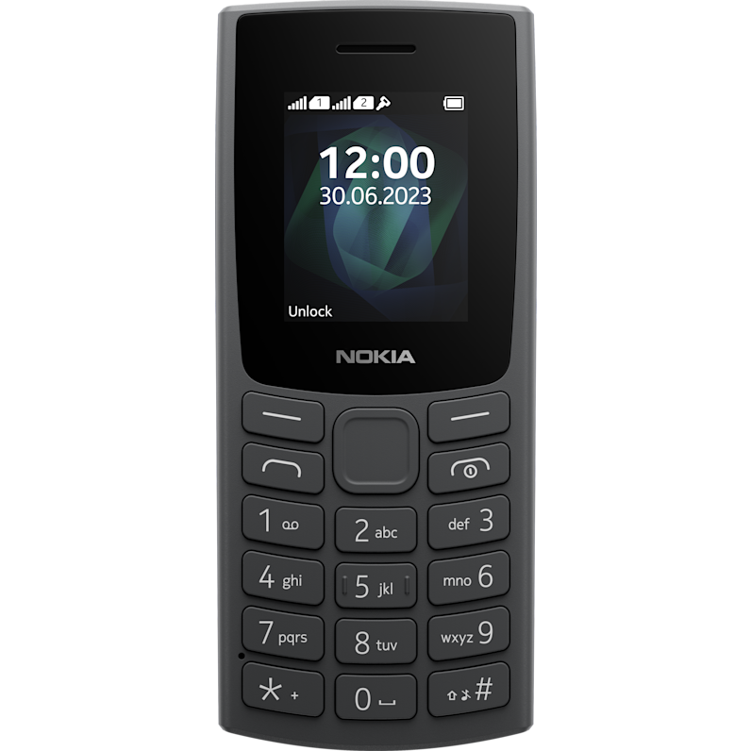
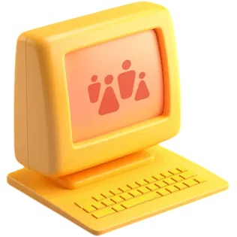


Possible solutions
Agreeing with like-minded parents to delay introduction of smartphones
“Old-fashioned” mobile telephones without internet until 14 years
A child’s own smartphone at earliest 14 years
A child’s own social media accounts at earliest 16 years
Access to the internet and to chats via a shared family computer
A loan phone for the family
etc.
Smartphone
Social Media
Simple mobile phone
Family computer

Slide 19

So let’s all say “later”!
This reduces peer pressure and gives our children the chance to experience a childhood without distractions – free from age-inappropriate content and algorithms.
Technology offers enormous advantages.
Young people should be able to use these opportunities
– when they are ready and when it is safe.
A step in favour of childhood,
not against technology.

Slide 20
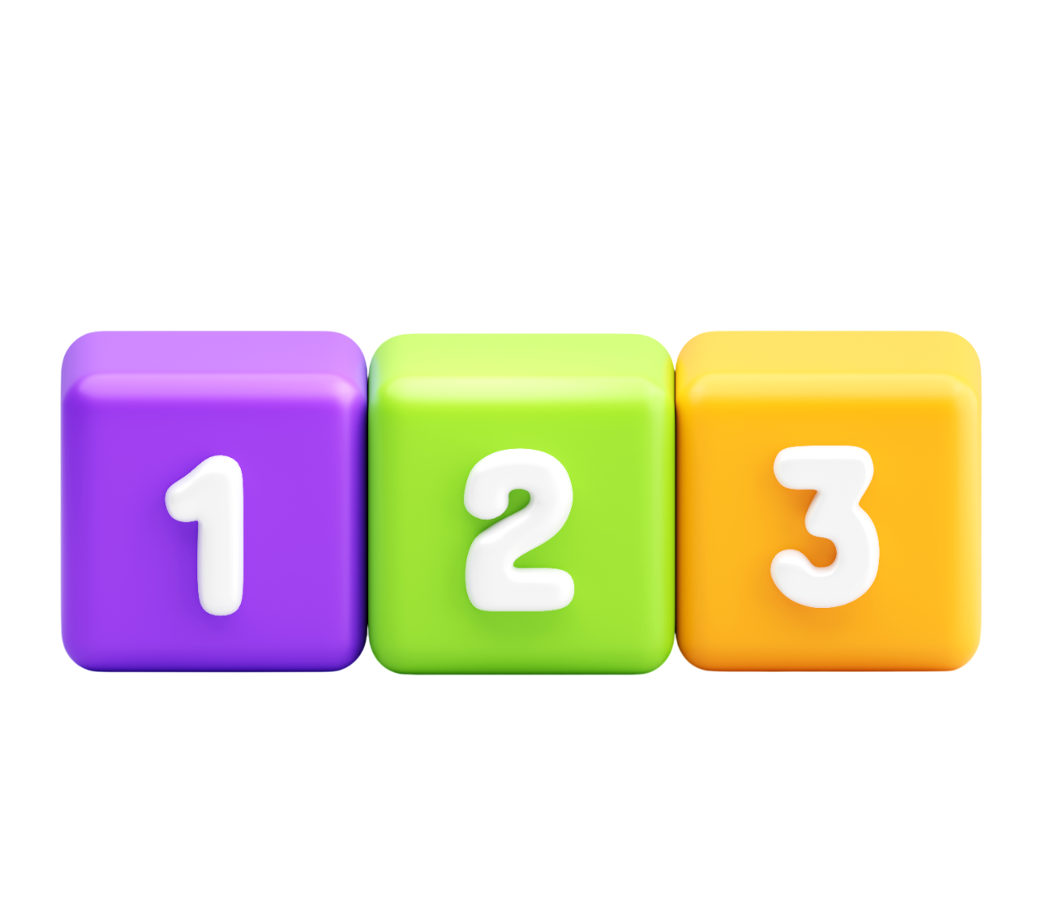
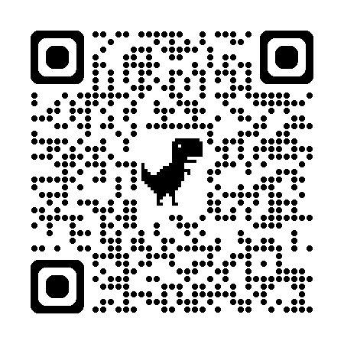

Possible common solutions
Signing a voluntary, Swiss-wide Parent Pact
Making your own agreements within a class or an association
Having an informal discussion about what's actually important to us. Scheduling a follow-up meeting.

Slide 21

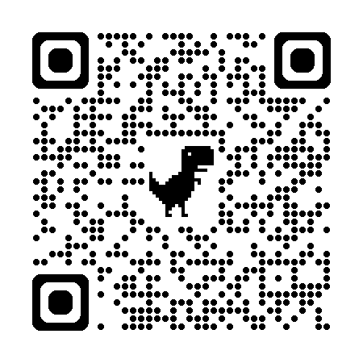
Questions for the group
What are your biggest concerns regarding a child’s first smartphone?
What are your thoughts about children getting their own social media accounts ?
What else could we do to help our children
in this matter?
What do you think of the Parent Pact? Do you have any concerns?
Connect with other parents in the chat group (by canton):
Infos,
tips and resources:

Slide 22
Appendix
***Note to the presenter: only show this slide if it seems appropriate.***

Slide 23
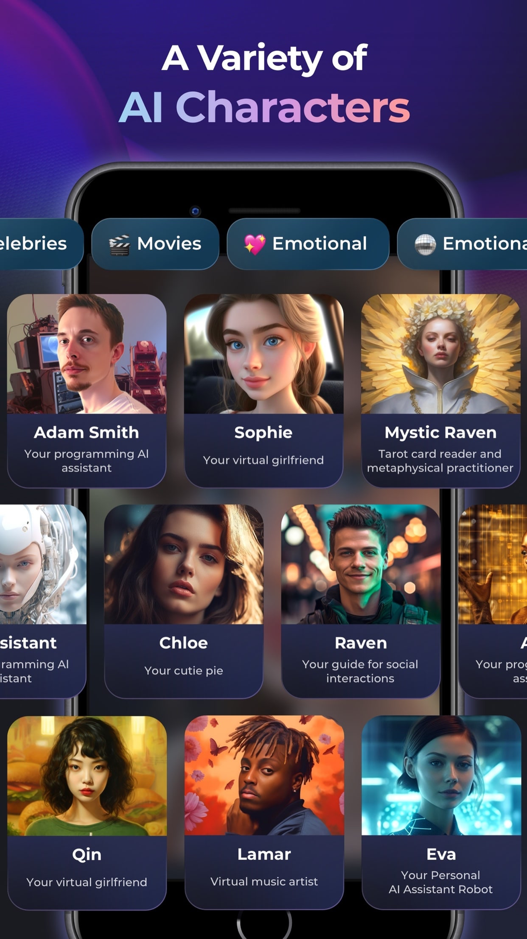
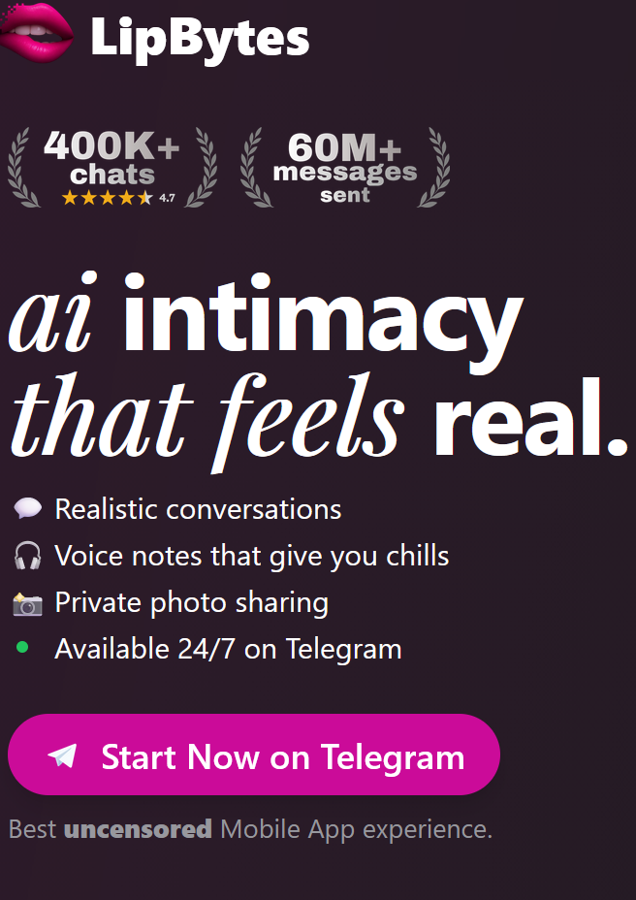
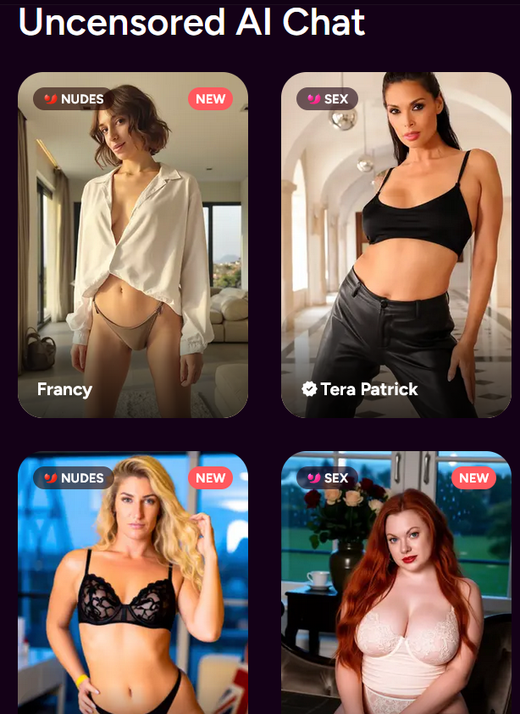

AI simulates intimacy
“Young people receive unconditional affection and validation from AI companions and chatbots. AI offers the perfect escape from the performance pressure of social media. However, this simulated intimacy atrophies precisely the social skills that are needed for relationships in the real world.” (translation)
David Murdoch
Digital media educator
Founder of PixelKäse

